Slide 1
Transparency in Action
Disclosure Practices in Irish Charities Today
Wednesday 28th June, 2017
Patricia Quinn (MD)

Slide 2
The disclosure spectrum
Mandatory company disclosures – prepared by the Directors, adopted by the Members, returned to the Companies Registration Office (which makes them public) at least once a year
      Constitution (and any changes) and company details in the first instance
      Secretary and Directors names; dates of appointment/retirement; other Directorships, other company disclosures
      Annual company return including Directors report and financial statements http://www.irishstatutebook.ie/eli/2014/act/38/section/326/enacted/en/html
Mandatory charity disclosures at least once a year
      Narrative and financial return to the Charities Regulatory Authority (Charities Act S.39)
      Financial statements for non-companies http://www.irishstatutebook.ie/eli/2009/act/6/section/39/enacted/en/html#sec39
Mandatory disclosures to funders
      Department of Public Expenditure & Reform Circular 13/2014
      https://www.google.ie/search?q=dper+circular+13%2F2014&oq=dper+circular+13%2F2014&aqs=chrome..69i57.10955j0j7&sourceid=chrome&ie=UTF-8
      Voluntary public disclosures: each charity’s own approach to telling its own story
        Website, facebook, published annual reports etc

Slide 3
Disclosure in practice: new minimum standard for
companies (FRS 102), some divergent trends…
  FRS 102 requires all company Directors to provide a narrative report, disclose salary levels in bands of €10,000 above €70,000
  Companies Act 2014 has extended eligibility for abridged financial reporting to CLGs: 4-fold increase in charities filing abridged financial statements
c) Sector leaders have adopted enhanced financial reporting: steady increase in charities adopting Charities SORP

Slide 4
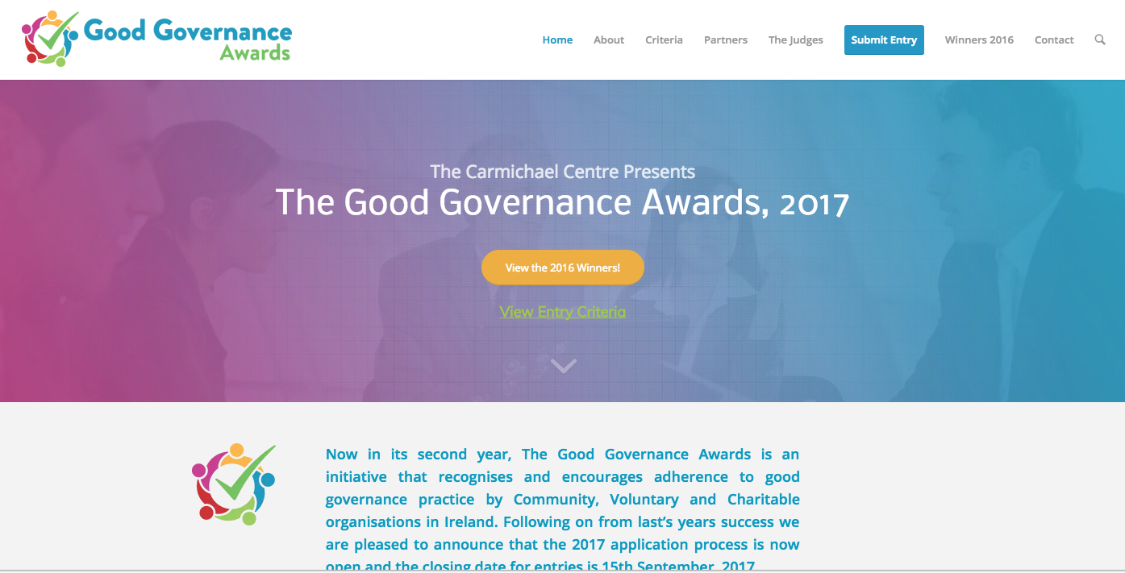
… and leadership within the sector in raising standards

Slide 5
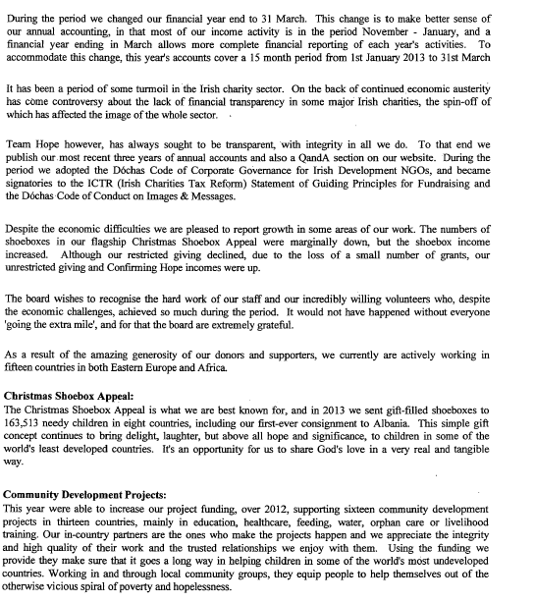
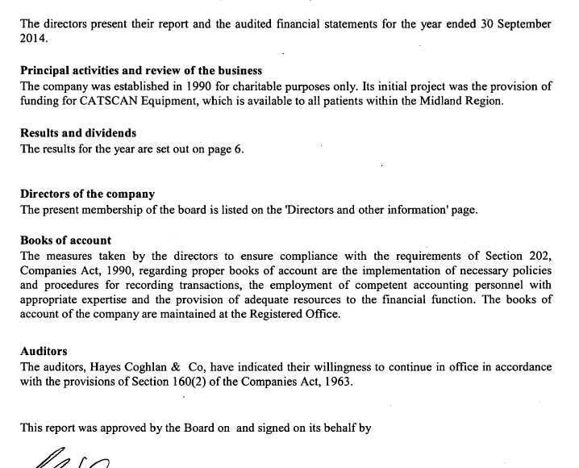
Narrative disclosures vary widely

Slide 6
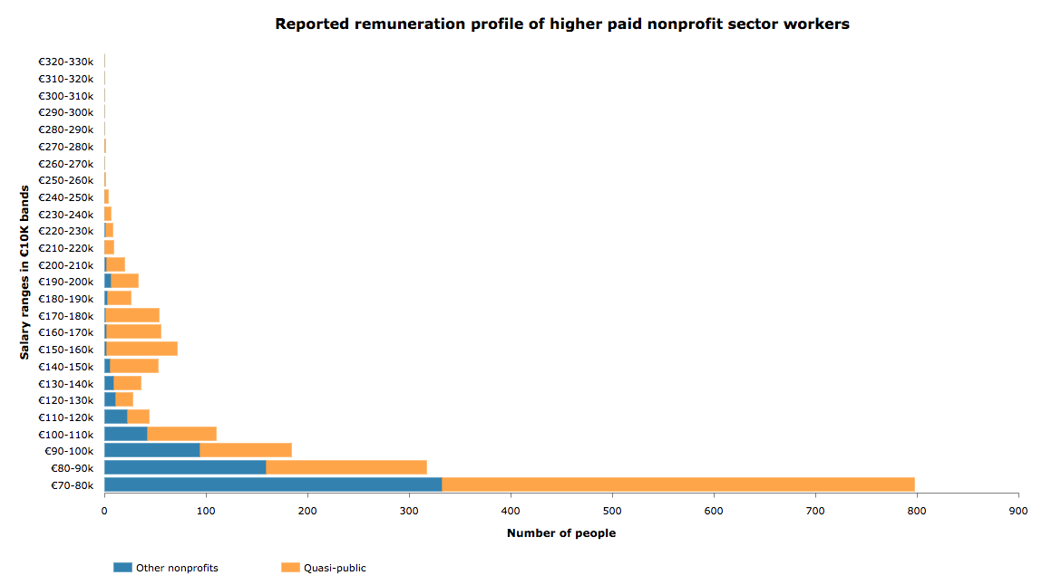
FRS 102 means we now have trend data on remuneration

Slide 7
A quarter of charities are publishing abridged financial statements
Permitted for CLGs under the Companies Act, 2014
Provides balance sheet, auditor’s report, notes to the accounts - but no income and expenditure data
Source of concern to funders, regulators, public

Slide 8
The use of SORP is growing steadily – but still <10% of all charities

Slide 9
International development, health, arts are the leading sectors
to adopt Charities SORP
 | Number of nonprofits in that sector | SORP reporters as % of nonprofits in that sector
Social Services | 1913 | 5.49%
International | 346 | 19.65%
Health | 707 | 9.62%
Development, Housing | 3063 | 2.22%
Arts, Culture, Media | 913 | 6.35%
Education, Research | 5155 | 0.97%
Philanthropy, Voluntarism | 800 | 4.88%
Religion | 1302 | 3.00%
Advocacy, Law, Politics | 370 | 6.22%
Professional, Vocational | 959 | 1.25%
Environment | 739 | 1.22%
Recreation, Sports | 3181 | 0.09%

Slide 10
More and more Wheel members are using SORP
Charities SORP adopted as the financial reporting standard by
2013 297 members of the Wheel
2014 326 members of the Wheel
2015 433 members of the Wheel

Slide 11
In summary
FRS102 – mandatory since the beginning of 2015 – has already improved the range of information being reported (activity reports, salary levels)
SORP reporting is growing steadily, especially in sectors where donors/funders have taken an active role in promoting it – but it’s still used by a small minority of charities
Regulatory provisions are not consistent (yet) - Charity Regulator’s push for better disclosure is at odds with Companies Act provision for smaller CLGs to file abridged accounts
Government funders are seeking greater levels of disclosure, but there is evidence that full accounts are being provided to them and abridged version filed in CRO for public consumption
Quality of narrative reporting still varies very widely, with most Directors still producing “boilerplate” text

Slide 12
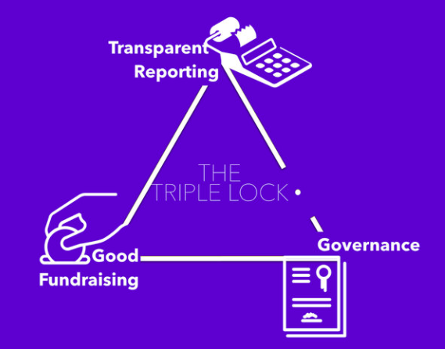
Factors that will drive change
1 Peer pressure: sector lead bodies are actively promoting better disclosure as part of the answer to restoring public trust

Slide 13
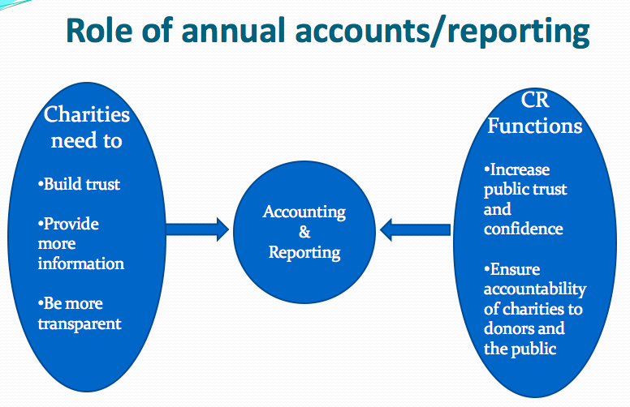
Factors that will drive change
2 Regulation: the CRA has consulted on a new financial reporting standard, to be issued soon

Slide 14

Factors that will drive change
3 Funders: both private and public are increasingly relying on Directors’ Reports as a source of information

Slide 15
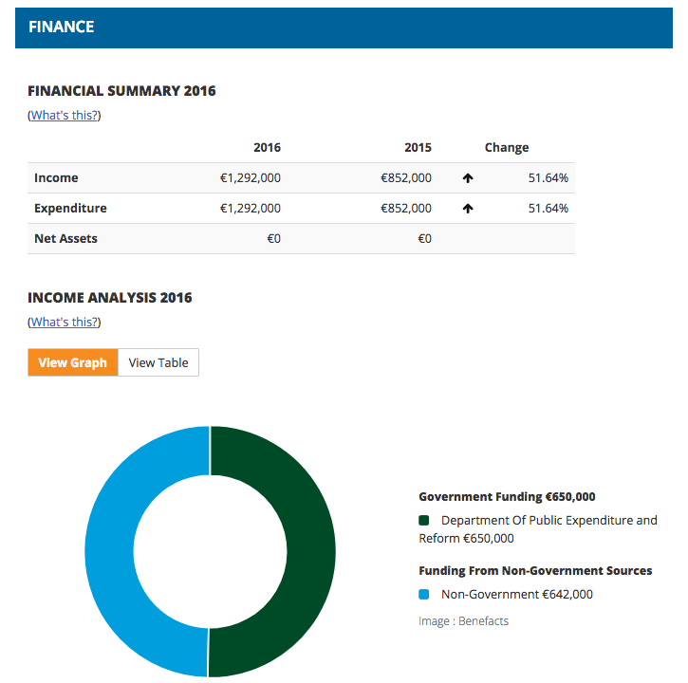
Factors that will drive change
4 Benefacts! Free public website is bringing disclosure standards into public view more than ever before

Slide 16
Some of the factors impeding better disclosure
Lack of familiarity with charity reporting among the audit community
Reluctance to be ahead of the curve – “wait and see”
Cost: there’s real (once-off) effort involved in moving from traditional accounting to SORP conventions, many smaller charities lack in-house expertise

Slide 17
What you can do
Look at best practice – winners of the good governance awards are one place to start https://goodgovernanceawards.ie/winners-2016/
Adopt better narrative reporting right away: use a structure that describes, at minimum
  the mission and how the performance of the company and the activities during the year contributed to the achievement of this
  Key events and future plans
  An overview of the financial position including important trends during the year, provision for reserves, risk management
Ask your auditors to advise on transitioning to SORP, starting with a re-analysis of income (restricted and unrestricted) and expenditure; schedule a discussion on your Board’s agenda
Appoint a disclosure champion on your staff or Board - start planning your annual report six months out

Slide 18
“HONESTY AND TRANSPARENCY MAKE YOU VULNERABLE
BE HONEST AND TRANSPARENT ANYWAY”

Slide 19

For more information:
patricia.quinn@benefacts.ie
or info@benefacts.ie
6 Merrion Square, Dublin 2
www.benefacts.ie
01-536 7131
Follow us on @benefacts_ie
www.linkedin.com/company/benefacts

