Slide 1

PROVIDING A DATA INFRASTRUCTURE
FOR THE IRISH NONPROFIT SECTOR

Slide 2

Benefacts|
A not-for-profit organisation established in 2015 in a strategic collaboration between the Irish government, civil society and major philanthropies to create and deploy a data infrastructure for a sector that employs 150,000 people in Ireland and attracts 10% of public current expenditure.

Slide 3
Benefacts brings the full population of Irish nonprofit institutions* into plain view
local community and voluntary associations | clubs, associations and societies for sports, recreational, cultural, environmental or social goods | philanthropies and fund-raising foundations | political, business, professional and representative bodies including trades unions | schools and colleges | sports governing bodies | churches and faith-based organisation | not-for-profit companies, friendly societies, cooperatives and social enterprises
(only some defined as charities in Irish law)
_________________________________________________________________________________________________
*“Non-profit institutions serving households, abbreviated as NPISH, make up an institutional sector in the context of national accounts consisting of non-profit institutions which are not mainly financed and controlled by government and which provide goods or services to households for free or at prices that are not economically significant.
NPISH are private, non-market producers which are separate legal entities. Their main resources, apart from those derived from occasional sales, are derived from voluntary contributions in cash or in kind from households in their capacity as consumers, from payments made by general governments, and from property income.”
http://ec.europa.eu/eurostat/statistics-explained/index.php/Glossary:Non-profit_institutions_serving_households_(NPISH)

Slide 4


Benefacts finds nonprofits in public open datasets, and normalises available data into a single database, updated daily
DATABASE OF IRISH NONPROFITS
2016
2015
Department of Education and Skills
2014
2013

Slide 5
Benefacts places no filing burden on listed nonprofits…
Open data files are retrieved from many public sources
Data feeds are purchased from licensed re-sellers of public data
Additional information is digitally captured from documents filed by nonprofit with regulators
Text-matching algorithms are used to normalise data about the same organisations harvested from multiple sources
Manual data entry is used to harvest financial and governance data from audited financial statements

Slide 6
… and at minimum produces this dataset for all 20,000
Registered name/other registered names
Address
URL *
Eircode
County
Name(s) of all authorities by which the nonprofit is regulated/with which it is registered
Regulatory number(s)
Link to nonprofits listing on Benefacts.ie *
Classification assigned by Benefacts in line with UN/Eurostat taxonomy *
Unique Business Identifier *
* Discovered/assigned by Benefacts
Notes:
At minimum, a Base Register

Slide 7
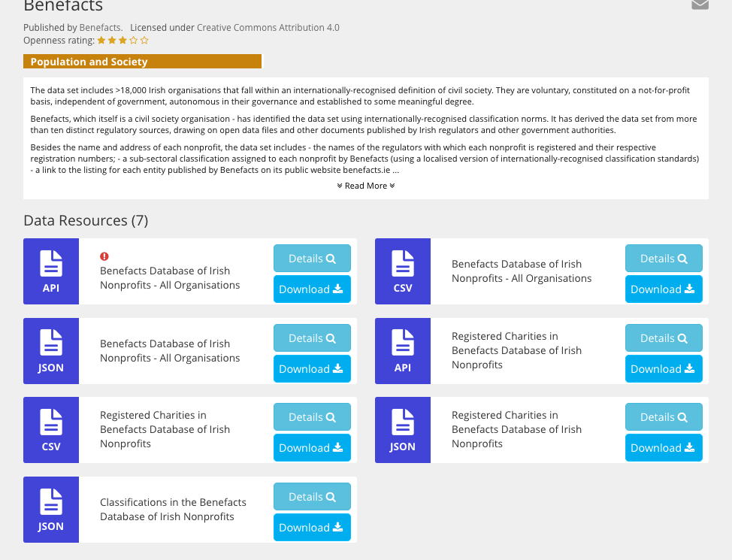
… which it publishes on the Government’s free Open Data portal, data.gov.ie
Notes:
At minimum, a Base Register

Slide 8
Rich financial and governance can be extracted from files in the case of ~10,000 nonprofits…
Institutional form | statement of legal purpose | directors’/trustees’ reports on activities | average number of reported employees | remuneration of employees in €10,000 bands in excess of €70,000 |names and dates of appointment of serving directors/trustees | reported total income | all reported sources of income | reported expenditure | reported net assets | auditors’ qualification/opinion | compliance with voluntary codes for financial reporting, governance, fundraising best practice

Slide 9
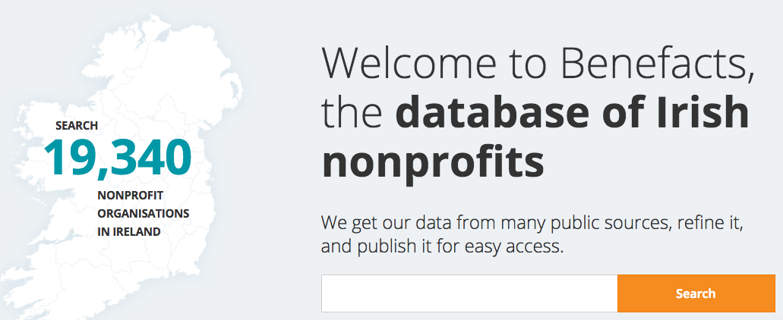
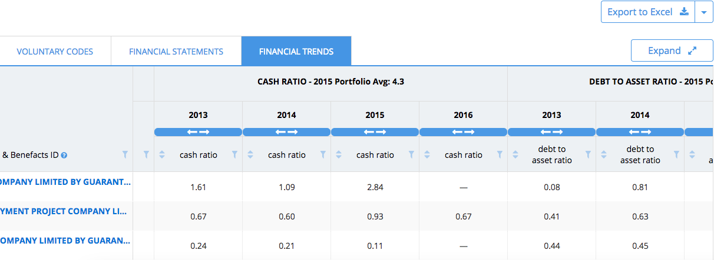
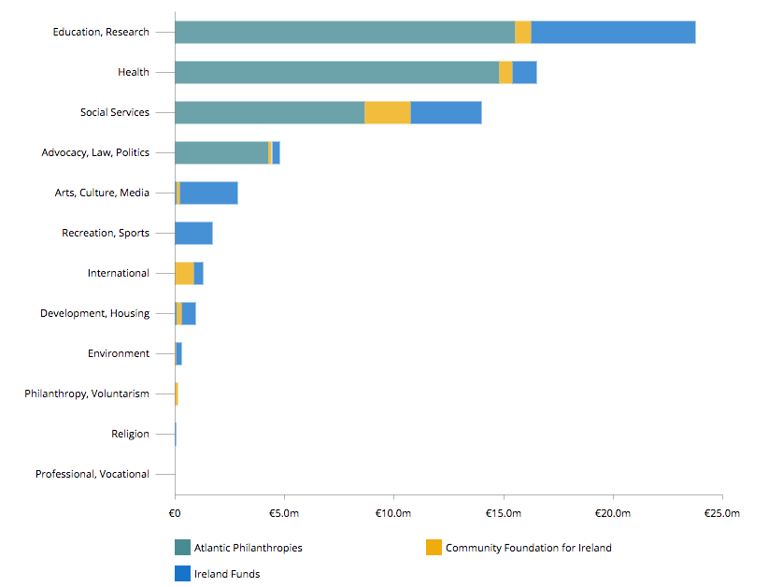
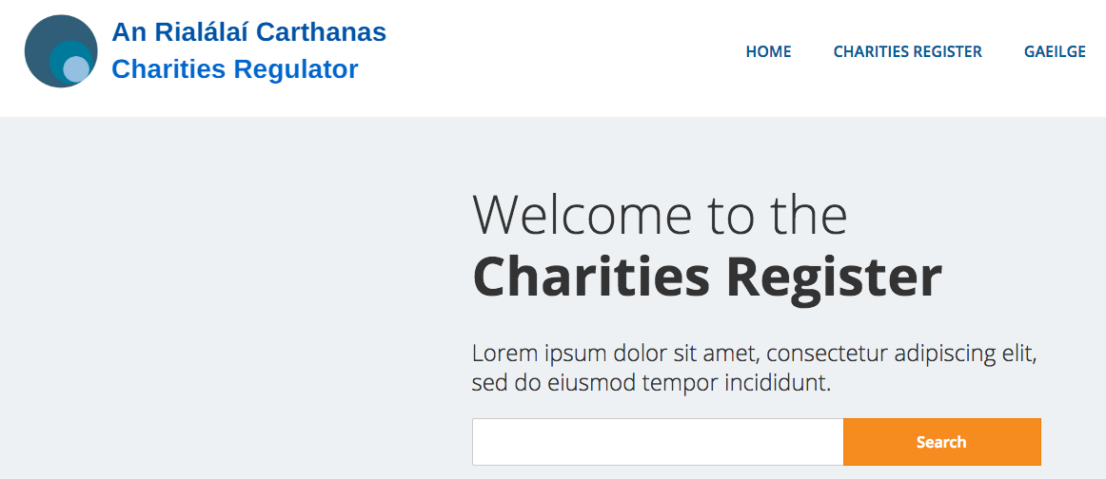



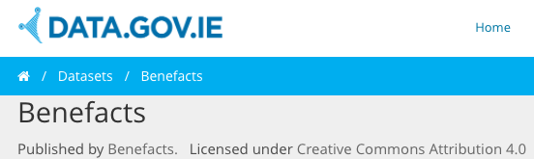



Free public website
…which Benefacts deploys in various ways,
Governance, risk,
compliance service
Benefacts Analytics
DATABASE OF IRISH NONPROFITS
Annual Sector Analysis Report
2016
Online register for the Charities Regulator Sept 17
2015
2014
2013
Data for Government, nonprofits
Open dataset on govt. portal

Slide 10
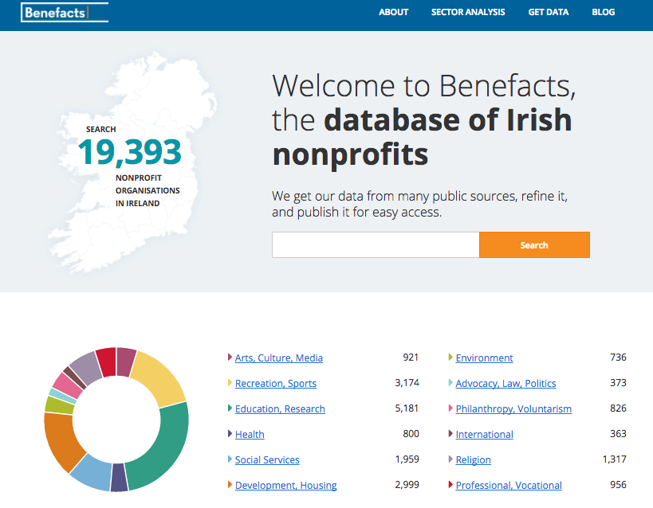
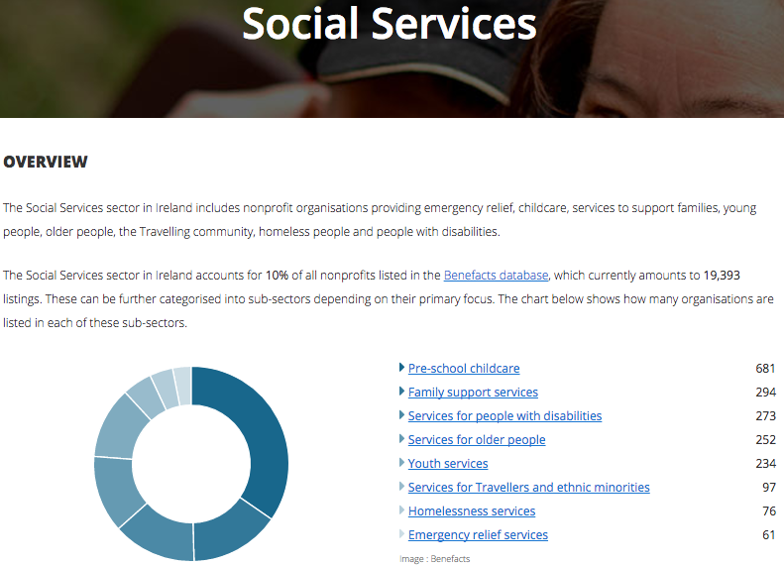
including a free public website - www.benefacts.ie -
which facilitates search by sub-sector…

Slide 11
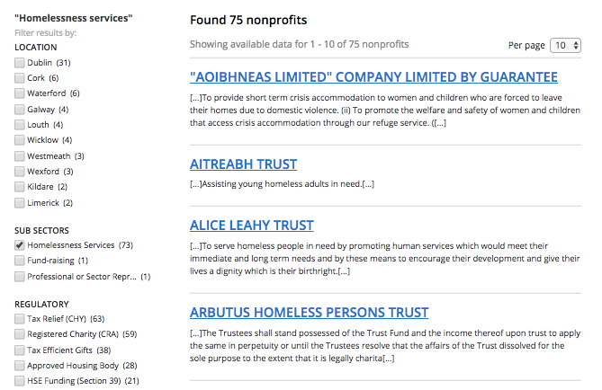
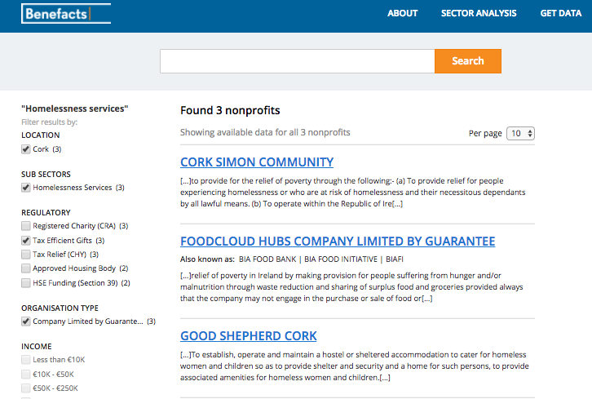
…facet search functionality which facilitates further analysis

Slide 12
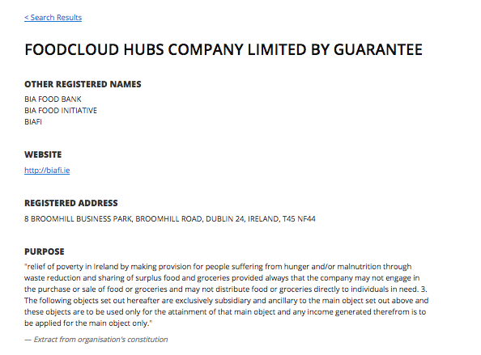
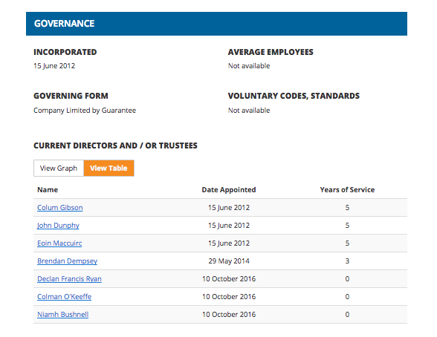
…and a unique listing for every individual nonprofit …

Slide 13
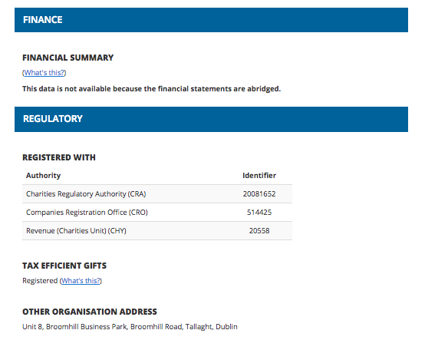
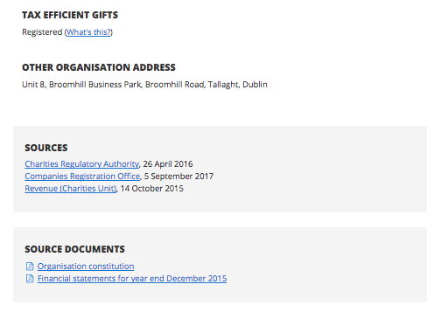
… that also gives users free access to the source documents from which the extracts have been taken

Slide 14
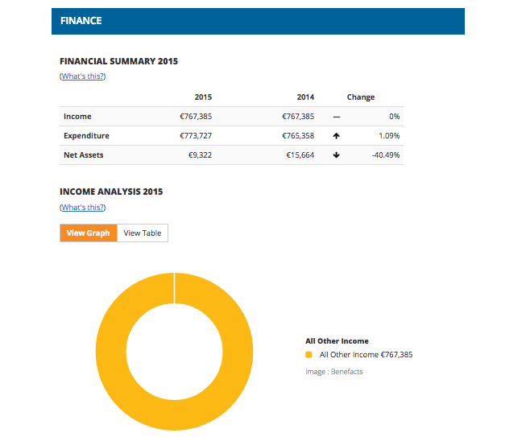
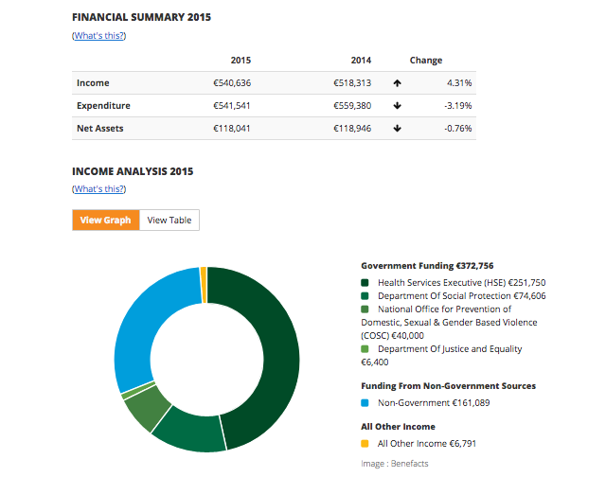
The better the source data, the fuller the listing
THE CARETAKERS PROJECT
SAFE IRELAND

Slide 15
Benefacts has also developed a specialised web-based governance, compliance and risk service for institutional users in government, and elsewhere

Slide 16
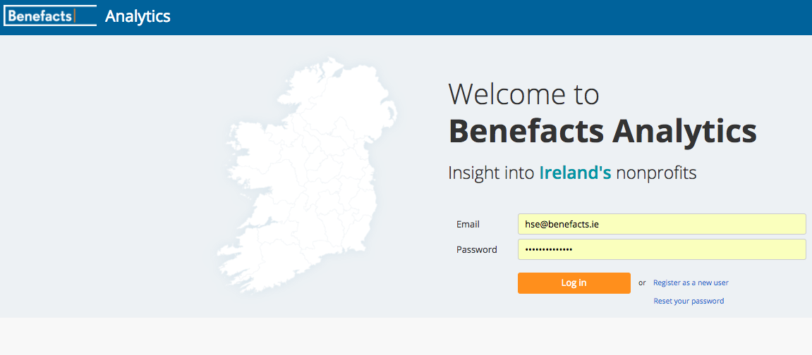

Slide 17
A powerful resource to support analysis, due diligence, internal audit, risk assessment
  The features of Benefacts Analytics have been derived from consultation: all are already in use in public administration
  Full population data (10,000 sets of accounts annually) significantly improves the capacity for risk recognition
  Analysis within portfolios permits comparison with peer norms/trends over time
  Whole-of-government access facilitates information-sharing
  Download feature permits further analysis, cross-referencing with other data

Slide 18
Why does this matter?
Efficiency | more effective use of public resources, reduced transaction overheads
Accountability| voluntary-led organisations are advocates, thought leaders as well as providers of public services
Information assymetry | data infrastructure for nonprofits has lagged behind the private sector: nonprofit sector leaders need business intel like everyone else
Transparency | citizens deserve to see the full picture

Slide 19
How this delivers for public administration
optimising the use of existing data (“tell us once”)
improving the communication of Government’s engagement with civil society
providing an infrastructure to strengthen whole-of-Government collaboration,
provided an unprecedented body of timely and reliable evidence to support decision-making

Slide 20
patricia.quinn@benefacts.ie
info@benefacts.ie
+353 87 648 8441
6 Merrion Square, Dublin 2, Ireland
www.benefacts.ie
www.twitter.com/Benefacts_ie
www.linkedin.com/company/Benefacts

